Slide 1

Small Enterprises to Strengthen Rural Economy: Challenges & Opportunities
Dr.S. GLORY SWARUPA
DIRCETOR GENERAL
National Institute for Micro, Small & Medium Enterprises (ni-msme)
An Organisation of Ministry of MSME, Govt. of India and ISO 9001:2015 Certified
Accredited as UTKRISHT / उत्कृष्ट, 3-Star Rating by Capacity Building Commission (CBC)
Yousufguda, Hyderabad - 500045 | www.nimsme.org

Slide 2

MSME Sector - An Overview
Contribute 29% to GDP in 2021-22*
Contribute 36% to Manufacturing Output in 2021-22*
Second largest employer after Agriculture
Contribute 44% to Export in 2022-23#
MSME (Udyam) Registration including Udyam Assist Platform (UAP) 5,22,74,395
Total Employment 22,35,61,944
Over 6000 products
* National Statistical Office, Ministry of Statistics & PI
# Directorate General of Commercial Intelligence & Statistics
National Institute for Micro, Small and Medium Enterprises (ni-msme), Hyderabad
2

Slide 3
New Definition for MSMEs (2020)
(Rs. in Crore)
Category | Investment Not exceeding | Turnover Not exceeding
Micro Enterprise | 1.0 | 5.0
Small Enterprise | 10.0 | 50.0
Medium Enterprise | 50.0 | 250.0
(One Crore equals to 10 million)
National Institute for Micro, Small and Medium Enterprises (ni-msme), Hyderabad
3

Slide 4
Organisations under the Ministry of MSME
Ministry of Micro, Small & Medium Enterprises
Office of Development Commissioner (DC-MSME)
Khadi and Village Industries Commission (KVIC)-64 FO
National Small Industries Corporation (NSIC)-102 FO
National Institute for Micro, Small and Medium Enterprises (ni-msme)
Mahatma Gandhi Institute for Rural Industrialization (MGIRI)
Coir Board 54 FO
32 MSME Development & Facilitation Offices (MSME-DFOs)
30 Branch MSME-DFOs
23 MSME Technology Centers
7 MSME Testing Centers
7 MSME Testing Stations
National Institute for Micro, Small and Medium Enterprises (ni-msme), Hyderabad
4

Slide 5
Major Challenges Faced by MSME Sector
Formalization and inclusion
Access to credit
Access to finance
Access to market
Access to technology
Access to digitalization
Infrastructural bottlenecks
Inadequate skilling/ reskilling
Ministry of MSME implements various schemes/ programmes/ initiatives to address these challenges
National Institute for Micro, Small and Medium Enterprises (ni-msme), Hyderabad
5

Slide 6
Kakinada Experiment - 1964
Prof. David McClelland
Achievement Motivation
First ever Entrepreneurship Development Programme
Youth of Fishermen Community
Vijay Electricals & Raja Cycle Company
National Institute for Micro, Small and Medium Enterprises (ni-msme), Hyderabad
6

Slide 7
Genesis: National Institute for MSME (ni-msme)
1960
1984
2022
1962
2007
Took birth as Central Industrial Extension Training Institute (CIETI), New Delhi on the recommendation of Working Group for III five-year plan
Renamed as Small Industry Extension Training Institute (SIET), Hyderabad
UNIDO recognized as Center of Excellence National Institute for Small Industries Extension and Training (nisiet)
National Institute for Micro, Small and Medium Enterprises on 11th April 2007
Diamond Jubilee Celebrations
Objectives
Consultancy, Research, Information & Advisory Services
Entrepreneurship & Skill Development for MSME Promotion
Diagnostic & Research Studies for Policy Formulation
Documentation, Dissemination & Extension Services
Capacity Building & Development of Master Trainers
National Institute for Micro, Small and Medium Enterprises (ni-msme), Hyderabad
7

Slide 8


ni-msme Vision & Mission
Vision
To emerge as Centre of Excellence in Innovation and Entrepreneurship for sustainable growth of MSMEs while conforming to national priorities for attaining global standards
Mission
To play an active role in MSME policy formulation and implementation in priority sectors aligned with Sustainable Development Goals (SDGs)
To undertake demand driven Training, Research & Consultancy involving Industry and Academia
To develop curriculum, offer short/ long term courses and executive education programmes on entrepreneurship and MSME development as part of lifelong learning
To impart innovative skills, support incubation, facilitate technology transfer, multiplication and commercialization including evolving Innovations & Pilot Testing
To create Master Trainers for providing mentoring & hand-holding services to potential and practicing entrepreneurs
To establish linkages with international agencies, different Ministries of Government of India, and state governments where demand exists for MSME development
National Institute for Micro, Small and Medium Enterprises (ni-msme), Hyderabad
8

Slide 9

ni-msme Services
Research
Consultancy
Educational Programmes
Extension
SEDME
Training
JIEMS
Executive
Management
FDP/ ToT
Entrepreneurship
Skill
Training
On / Off Campus
Hybrid Mode
National Institute for Micro, Small and Medium Enterprises (ni-msme), Hyderabad
9

Slide 10

ni-msme is awarded with National Standards for Civil Services Training Institutions (NSCSTI) Accreditation Certificate as “UTKRISHT”/ उत्कृष्ट, 3-Star Rating by Capacity Building Commission (CBC)
National Recognition
National Institute for Micro, Small and Medium Enterprises (ni-msme), Hyderabad
10

Slide 11

Schools of Excellence
SED
SEM
SEE
SEIC
School of Enterprise Development
School of Enterprise Management
School of Entrepreneurship & Extension
School of Enterprise Information & Communication
Economic Investigation
Industrial Potential
Cluster Development
Green Energy Initiatives
Micro Finance
NGO Networking
Biochar
FinRISE
Intellectual Property Rights
Import and Export Principles
Training Methodologies
Productivity and Quality
General Management
Entrepreneurship Development
Training of Trainers
Curriculum Development
Training Techniques
Women Empowerment
Evaluation Studies
Informational Needs of MSMEs
Communication
Information Technology
Documentation
Report Preparation
National Institute for Micro, Small and Medium Enterprises (ni-msme), Hyderabad
11

Slide 12
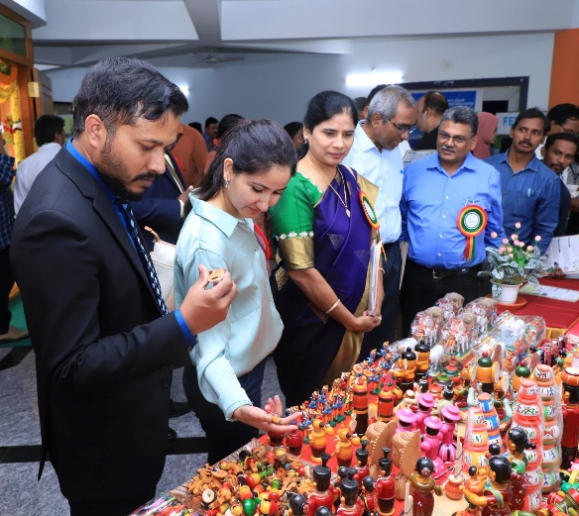
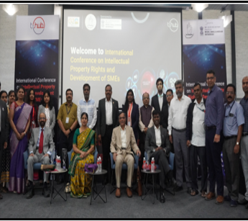
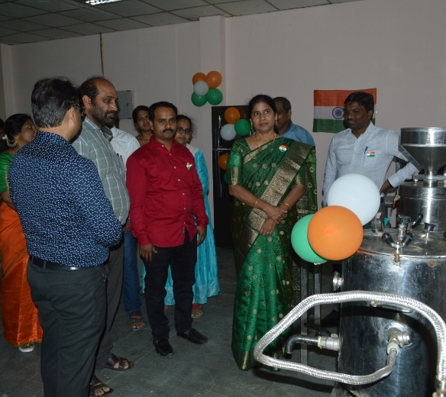

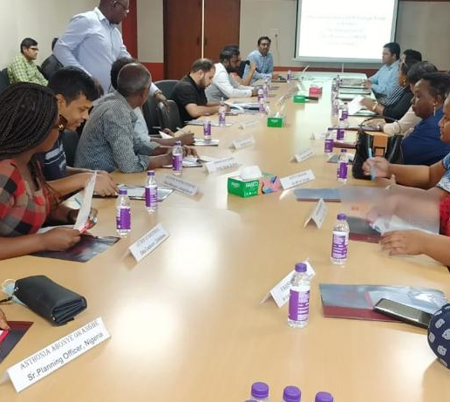

Centers of Excellence
National Resource Centre for
Cluster Development
Financial Innovation & Research for Sustainable Enterprises
Intellectual Property Facilitation Centre
Livelihood Business
Incubator
Digital Branding
NRCD
IPFC
LBI
FinRISE
CDB
National Institute for Micro, Small and Medium Enterprises (ni-msme), Hyderabad
12

Slide 13
Core Competencies & Achievements
Core Competencies
Achievements (since inception)
MSME Promotion
& Development
Innovation, Incubation, Entrepreneurship, Stratups, Consultancy, Counseling, B2B & Conventions
Skill Building
Education
International
Executives: 11,019
Countries: 145
Information Dissemination & IT
Documentation & Publications
Training,
Execution & Extension
Survey Evaluation & Research
National Institute for Micro, Small and Medium Enterprises (ni-msme), Hyderabad
13

Slide 14
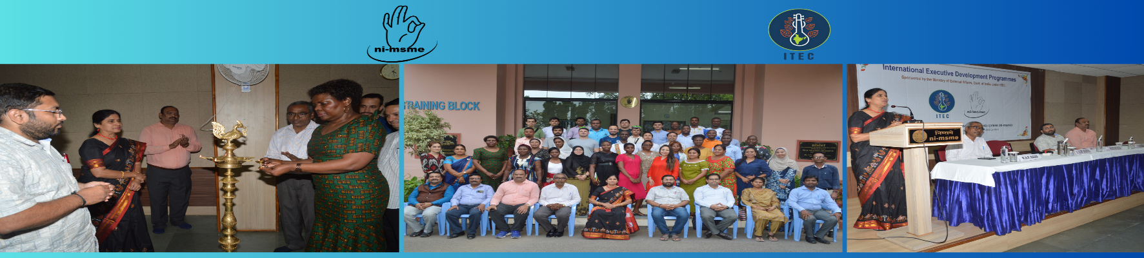
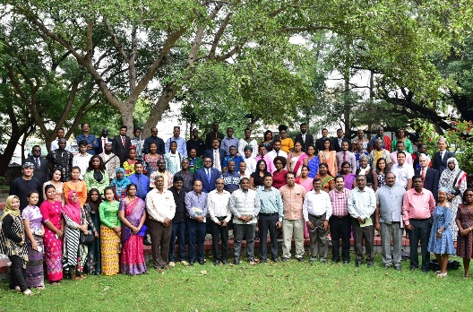

International Presence
International Executives : 11,019
Developing Countries : 145
FREQENTLY PARTICIPATING NATIONS
ASIA
EUROPE /SOUTH AMERICA
AFRICA
AFGHANISTAN
BANGLADESH
BHUTAN
INDONESIA
IRAN
IRAQ
MALAYSIA
NEPAL
MYANMAR
OMAN
PHILIPPINES
SRI LANKA
TAJIKISTAN
ARMENIA
CHILE
FIJI
RUSSIA
KAZAKHSTAN
LITHUANIA
ALGERIA
BOTSWANA
CAMBODIA
COTE D'IVOIRE
EGYPT
ETHIOPIA
GHANA
KENYA
MAURITIUS
NIGERIA
SUDAN
UGANDA
ZAMBIA
ZIMBABWE
National Institute for Micro, Small and Medium Enterprises (ni-msme), Hyderabad
14

Slide 15
CIRDAP Member Countries
PACIFIC
FIJI: 62
ASIA
AFGHANISTAN : 575
BANGLADESH : 578
INDONESIA : 178
INDIA : 5
IRAN : 63
Lao PDR : 83
MALAYSIA : 234
MYANMAR : 356
NEPAL : 175
PAKISTHAN : 21
PHILIPPINES : 252
SRI LANKA : 714
THAILAND : 172
VIETNAM : 142
National Institute for Micro, Small and Medium Enterprises (ni-msme), Hyderabad
15

Slide 16



















Our Collaborations
National Collaborations
International Collaborations
National Institute for Micro, Small and Medium Enterprises (ni-msme), Hyderabad
16

Slide 17

Scheme of Fund for Regeneration of Traditional Industries (SFURTI)
Role of ni-msme
Nodal Agency
Soft Interventions
Hard Interventions
National Institute for Micro, Small and Medium Enterprises (ni-msme), Hyderabad
17

Slide 18
List of SFURTI Clusters
Sr.No | Clusters Names | No. Of Artisans | Govt. of India Grant | SPV Contribution
1 | Kondapalli Wooden Toys Cluster, Andhra Pradesh | 448 | 143.00 | 29.50
2 | L.Kota Sesame Processing Cluster, Andhra Pradesh | 800 | 205.85 | 17.74
3 | Pulivendula Banana Processing Cluster, Andhra Pradesh | 910 | 360.09 | 32.24
4 | Bapatla Millet Processing Cluster, Andhra Pradesh | 307 | 238.60 | 21.00
5 | Chintapally Turmeric Cluster, Andhra Pradesh | 712 | 292.15 | 25.22
6 | Bundu Bamboo Cluster, Jharkhand | 698 | 393.76 | 35.59
7 | Lohardaga Honey Processing Cluster, Jharkhand | 253 | 145.46 | 26.23
8 | Sukhrigarh Gold & Silver Cluster, Jharkhand | 589 | 310.54 | 55.4
9 | Bundu Lac Processing Cluster, Jharkhand | 784 | 480 | 75.75
10 | Annatdev Wood Craft Cluster, Jharkhand | 257 | 238.84 | 20.59
11 | Kariyatpur Brass cluster, Jharkhand | 266 | 238.58 | 23.72
12 | Basantrai Badge & Embroidery Cluster, Jharkhand | 207 | 217.5 | 18.75
13 | Mangaon Bamboo Cluster, Maharashtra | 453 | 179.34 | 154.46
14 | SUS Readymade Garment Cluster, Maharashtra | 1055 | 427.8 | 39.2
Sr.No | Clusters Names | No. Of Artisans | Govt. of India Grant | SPV Contribution
15 | Sakoli Bamboo Cluster, Maharashtra | 439 | 193.76 | 57.46
16 | Wardha Bamboo Cluster, Maharashtra | 229 | 161.12 | 25.17
17 | Deomali Millet Cluster, Koraput, Odisha | 1113 | 497.48 | 46.94
18 | Mothkuru Ikat Handloom Cluster, Telangana | 402 | 143.38 | 29.84
19 | Pembarthi Metal Craft Cluster, Telangana | 200 | 149.96 | 31.5
20 | Nizamabad Turmeric Cluster, Telangana | 550 | 233.54 | 20.13
21 | Chandrugonda Bamboo Cluster, Telangana | 871 | 313.34 | 27.40
22 | Ieeza Handloom Cluster, Telangana | 210 | 140.80 | 28.95
23 | Poodur Vegetable and Fruit Processing Cluster, Telangana | 1629 | 430.56 | 39.51
24 | Jackfruit Processing Cluster, karnataka | 608 | 500.00 | 70.91
25 | Bathinda Honey Processing Cluster, Punjab | 1500 | 267.32 | 68
26 | Hoshiarpur Wooden Inlay Cluster, Punjab | 618 | 113.12 | 28
27 | Tirur Coconut flavoured Milk and Oil Processeing cluster , Kerala | 2200 | 245.89 | 66.99
National Institute for Micro, Small and Medium Enterprises (ni-msme), Hyderabad
18

Slide 19

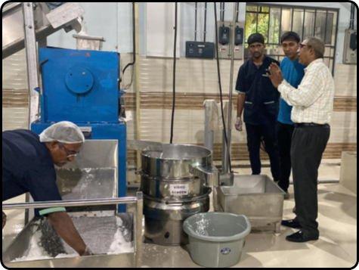
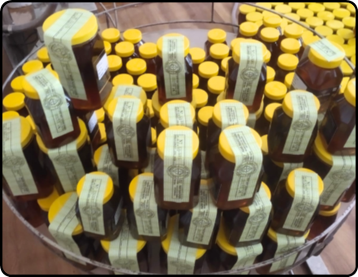
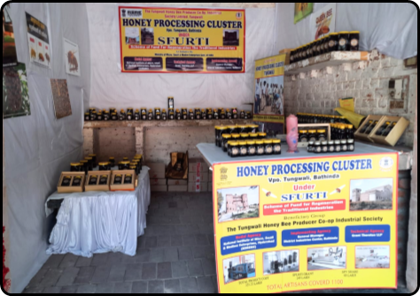
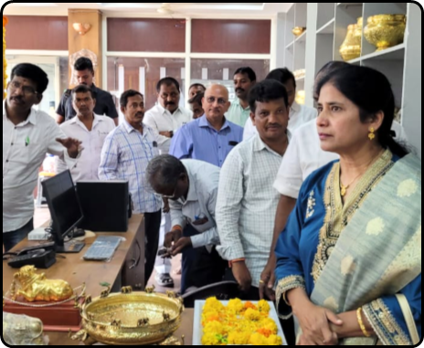
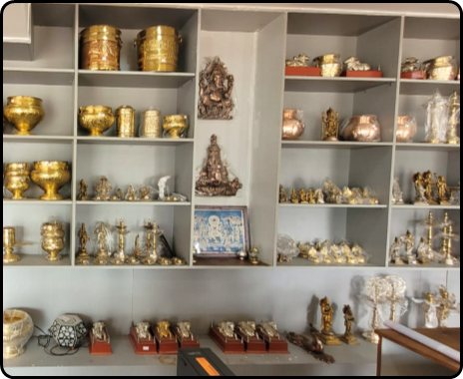
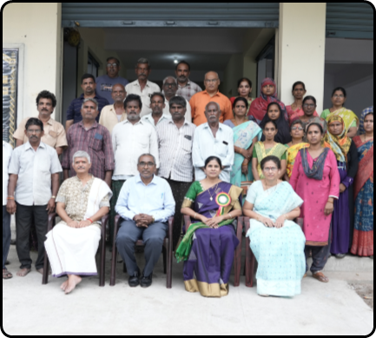
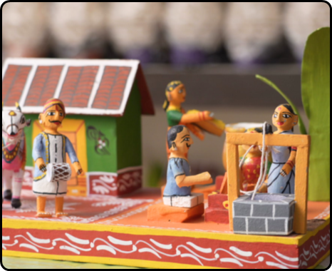
SFURTI Cluster Products
Integrated Coconut Processing Cluster, Tirur
Bathinda Honey processing Cluster
Pembarthy Metal ware Cluster
Kondapally Wooden toys Cluster
National Institute for Micro, Small and Medium Enterprises (ni-msme), Hyderabad
19

Slide 20
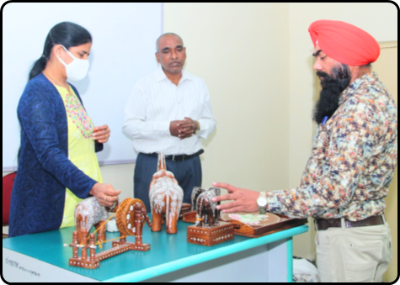
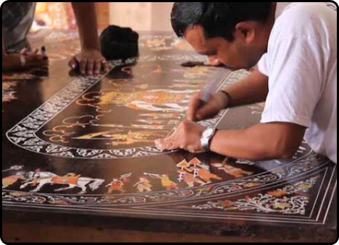
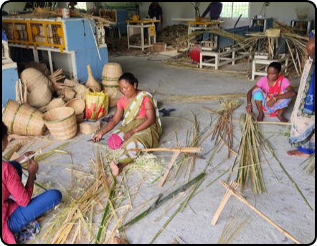
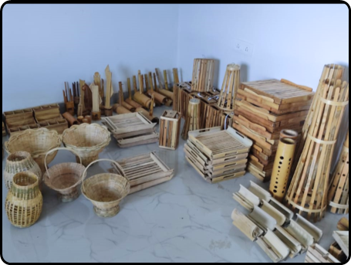
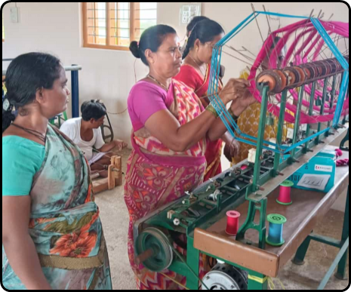
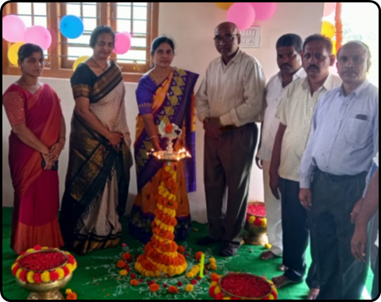
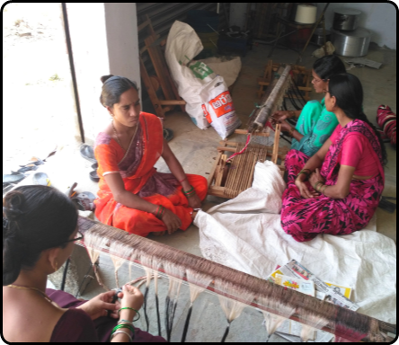
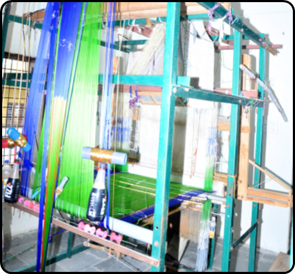
SFURTI Cluster activities
Hoshiyarpur Wooden inlay Cluster
Bamboo Bundu Bamboo Cluster
Ieeja Handloom Cluster
Mothkuru Ikat handloom Cluster
National Institute for Micro, Small and Medium Enterprises (ni-msme), Hyderabad
20

Slide 21
Prime Minister Employment Generation Program (PMEGP)
Objectives
A central sector scheme of Govt. of India by merging two schemes namely Prime Ministe’s Rojgar Yojana (PMRY) and Rural Employment Generation Programme (REGP)
Khadi and Village Industries Commission (KVIC), a statutory organization of the Ministry of MSME at National Level
At State level, implemented through State KVIC Directorates, State Khadi & Village Industries Boards (KVIBs), District Industries Centres (DICs) and Banks
To generate employment opportunities in rural as well as urban areas of the country through setting up of new self-employment ventures/projects/micro enterprises
To bring together widely dispersed traditional artisans/ rural and urban unemployed youth and give them self-employment opportunities to the extent possible, at their place
To provide continuous and sustainable employment to a large segment of traditional and prospective artisans and rural and urban unemployed youth in the country, so as to help arrest migration of rural youth to urban areas.
To increase the wage earning capacity of artisans and contribute to increase in the growth rate of rural and urban employment.
National Institute for Micro, Small and Medium Enterprises (ni-msme), Hyderabad
21

Slide 22
Prime Minister Employment Generation Program (PMEGP)
Levels of funding under PMEGP
Categories of beneficiaries under PMEGP | Beneficiaries Contribution (of project cost) | Rate of Subsidy (of project cost)
Area (location of project/ unit) |  | Urban | Rural
General Category | 10% | 15% | 25%
Special (including SC/ST/OBC/ Minorities/ Women, Ex-servicemen, Physically handicapped, NER, Hill and Border areas etc. | 05% | 25% | 35%
1) The maximum cost of the project/unit admissible for Margin Money subsidy under Manufacturing sector is Rs. 50 L
2) The maximum cost of the project/unit admissible for Margin Money subsidy under Business/Service sector is Rs. 20 L
3) The balance amount (excluding the own contribution)of the total project cost will be provided by Banks.
4) If the total project cost exceeds Rs. 50 L or Rs. 20 L for Manufacturing and Service/Business sector respectively, the balance amount may be provided by Banks without any Government subsidy.
National Institute for Micro, Small and Medium Enterprises (ni-msme), Hyderabad
22

Slide 23
Prime Minister Employment Generation Program (PMEGP)
Eligibility Conditions of Beneficiaries
Any individual, above 18 years of age
There will be no income ceiling for assistance for setting up projects under PMEGP
For setting up of project costing above Rs.10 lakh in the Manufacturing sector and above Rs. 5 lakh in the Business /Service sector, the beneficiaries should possess at least VIII standard pass educational qualification.
Assistance under the scheme is available only for new projects sanctioned specifically under the PMEGP. Existing Units (under PMRY, REGP or any other scheme of Government of India or State Government) are not eligible
Since its inception in FY2009, the scheme assisted more than 9.65 lakh micro enterprises PAN India
Generated employment for 7.9 million people till July 2024
Subsidies worth more than Rs 25,263.33 crore
National Institute for Micro, Small and Medium Enterprises (ni-msme), Hyderabad
23

Slide 24
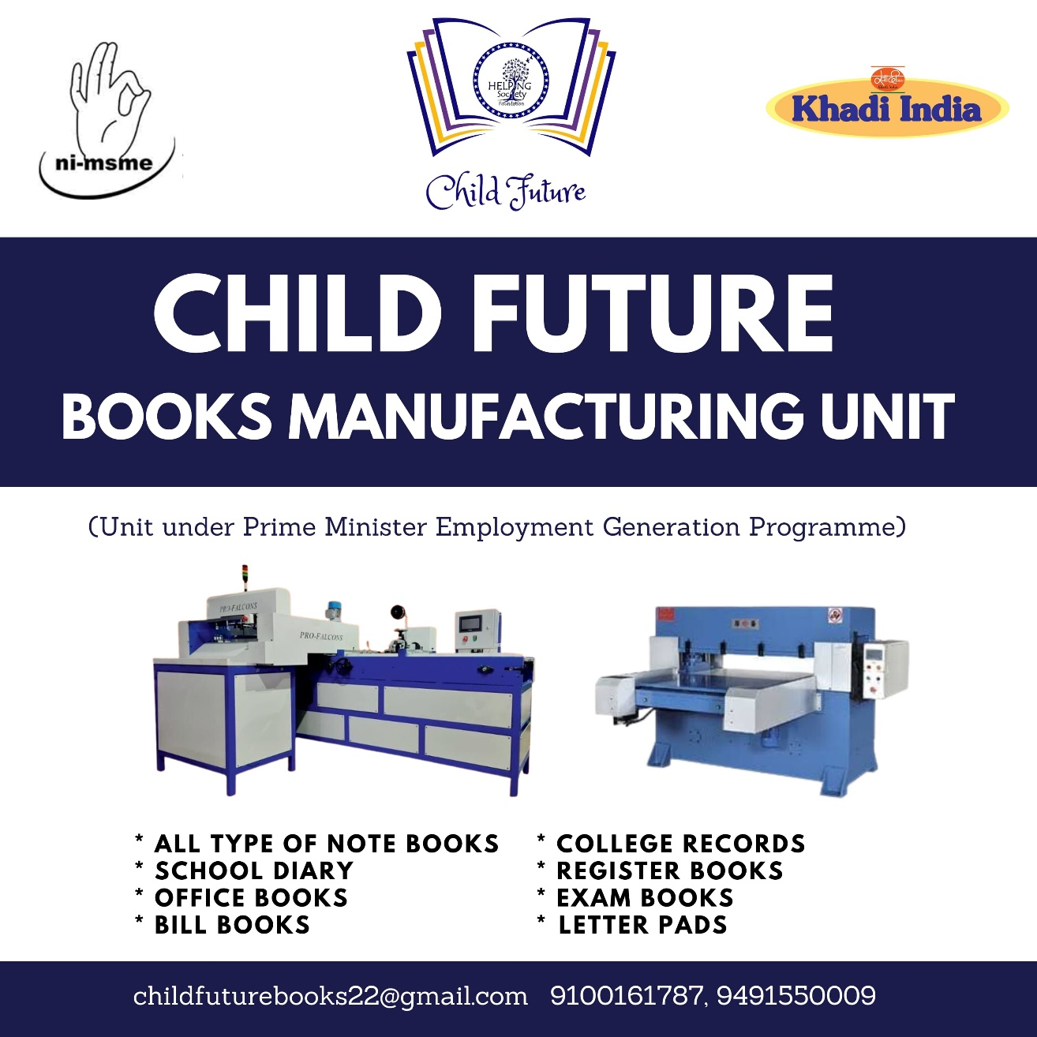


Slide 25
Skill Training for Educated Unemployed Youth
Assistance to Training Institutions (ATI) Scheme: Entrepreneurship and Skill Development Programs (ESDP)
More than 5.0 Lakh youth trained
Self/Wage employment: 30-35%
National SC-ST Hub (NSSH) scheme: Aims at capacity enhancement of SC/ST entrepreneurs and promoting "entrepreneurship culture" amongst the SC/ST population
The scheme is empowering the SC/ST population to participate in public procurement process and fulfill the mandated target of 4% procurement from SC/ST enterprises under Public Procurement Policy by the Ministries, Departments and CPSEs.
Since inception in 2016, several interventions/sub-schemes have been introduced in consultation with various stakeholders for capacity building, technology upgradation, market linkage, etc. of the existing & aspiring SC-ST entrepreneurs. As a result, more than 14-fold increase (in terms of value) in the procurement from SC-ST MSEs has been achieved from Rs. 99.37 Cr (0.07%) in FY 2015-16 to Rs.1468 Cr (0.84%) in FY 2022-23.
So far, 1.11 lakh existing & aspiring SC-ST entrepreneurs have been benefitted under the NSSH scheme.
National Institute for Micro, Small and Medium Enterprises (ni-msme), Hyderabad
25

Slide 26


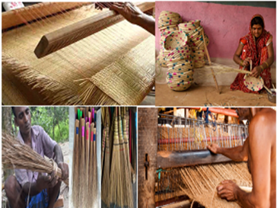
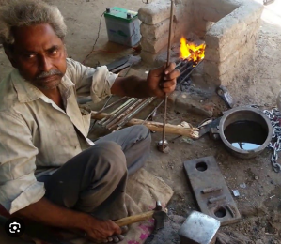

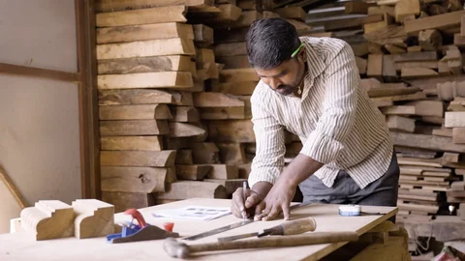
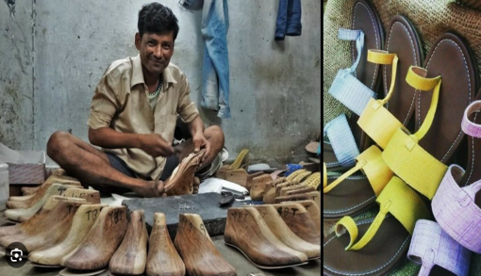
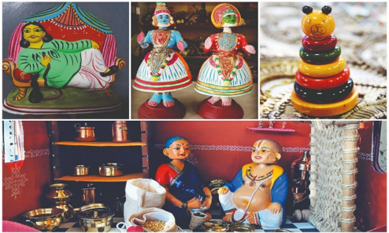

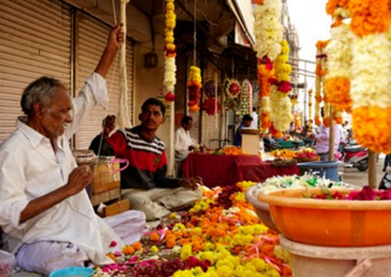
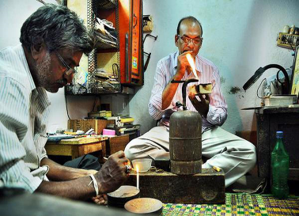
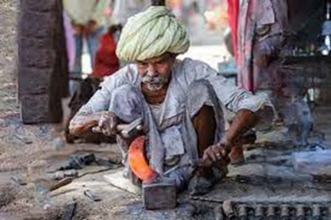
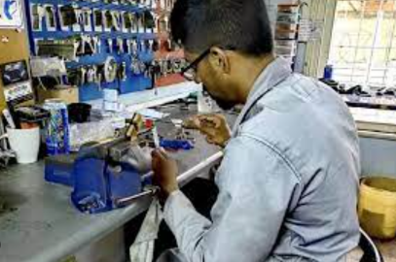
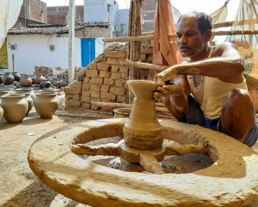
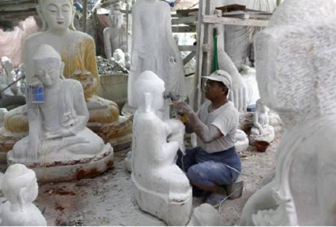
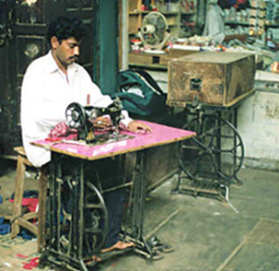
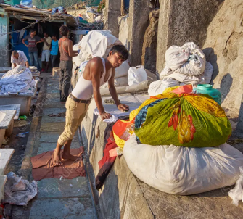
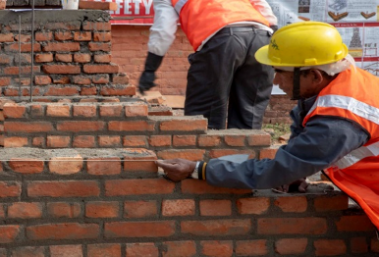
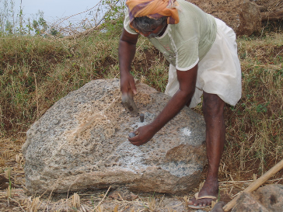
Prime Minister Vishwakarma (PM Vishwakarma)
PM Vishwakarma, a Central Sector Scheme, was launched on 17th September, 2023 by the Prime Minister to provide end-to-end support to artisans and craftspeople who work with their hands and tools. The Scheme covers artisans and craftspeople engaged in 18 trades viz.,
Armourer
Basket/Mat/Broom Maker/Coir Weaver
Blacksmith (Lohar)
Boat Maker
Carpenter (Suthar/Badhai)
Cobbler (Charmkar)/ Shoe smith/ Footwear artisan
Barber (Naai)
Doll & Toy Maker (Traditional)
Garland maker (Malakaar)
Goldsmith (Sonar)
Hammer and Tool Kit Maker
Locksmith
Fishing Net Maker
Stone breaker
Tailor (Darzi)
Mason (Rajmistri)
Potter (Kumhaar)
Sculptor (Moortikar, stone carver)
Stone breaker
Tailor (Darzi)
Washerman (Dhobi)
National Institute for Micro, Small and Medium Enterprises (ni-msme), Hyderabad
26

Slide 27
Prime Minister Vishwakarma (PM Vishwakarma)
Benefits to the Artisans and Crafts Persons
Recognition: Recognition of artisans and craftspeople through PM Vishwakarma certificate and ID card.
Skill Upgradation: Basic Training of 5-7 days and Advanced Training of 15 days or more, with a stipend of Rs. 500 per day.
Toolkit Incentive: A toolkit incentive of upto Rs. 15,000 in the form of e-vouchers at the beginning of Basic Skill Training.
Credit Support: Collateral free 'Enterprise Development Loans' of upto Rs. 3 lakh in two tranches of Rs. 1 lakh and Rs. 2 lakh with tenures of 18 months and 30 months, respectively, at a concessional rate of interest fixed at 5%, with Government of India subvention to the extent of 8%. Beneficiaries who have completed Basic Training will be eligible to avail the first tranche of credit support of upto Rs. 1 lakh. The second loan tranche will be available to beneficiaries who have availed the 1st tranche and maintained a standard loan account and have adopted digital transactions in their business or have undergone Advanced Training.
Incentive for Digital Transaction: An amount of Re. 1 per digital transaction, upto maximum 100 transactions monthly will be credited to the beneficiary's account for each digital pay-out or receipt.
Marketing Support: Marketing support will be provided to the artisans and craftspeople in the form of quality certification, branding, onboarding on e-commerce platforms such as GeM, advertising, publicity and other marketing activities to improve linkage to value chain.
The Scheme will onboard the beneficiaries on Udyam Assist Platform as 'entrepreneurs' in the formal MSME ecosystem. Enrolment of beneficiaries shall be done through Common Service Centres with Aadhaar-based biometric authentication on PM Vishwakarma portal.
National Institute for Micro, Small and Medium Enterprises (ni-msme), Hyderabad
27

Slide 28
MAHILA COIR YOJANA
Skill Upgradation & Mahila Coir Yojana (MCY) is one of the key schemes under the Scheme Coir Vikas Yojana which provides development of domestic and export markets, skill development and training, empowerment of women, employment/entrepreneurship creation and development, enhanced raw material utilization, trade related services, welfare activities for the coir workers, etc. MCY in particular, aims at women empowerment through the provision of spinning equipment at subsidzsed rates
This programme is intended to provide self employment opportunities to rural women artisans in regions processing coconut husk. Over the last two decades, production of coir fibre has substantially increased in India. Conversion of coir fibre into yarn on motorized ratts in rural households provides scope for large scale employment, improvement in productivity and quality of coir fibre, better working conditions and higher income, which ultimately leads to the improvement of standard of living of rural woman artisans. The programme envisages providing of training only to women artisans.
The financial assistance for procurement of machines/equipments may be obtained under PMEGP scheme for setting up of new coir units for which the maximum project cost is upto Rs.25 lakhs.
National Institute for Micro, Small and Medium Enterprises (ni-msme), Hyderabad
28

Slide 29
National Resource Organisation (NRO)
Sponsored under National Rural Livelihoods Mission (NRLM) by Ministry of Rural Development, Govt. of India
Supporting 13 states in preparing Detailed Project Reports (DPRs) and implementing the Start-up Village Entrepreneurship Program (SVEP), Impact Assessment studies and Business Development Service Providers (BDSPs) for the promotion of micro enterprises.
The National Resource Organization (NRO) under ni-msme engages in various activities to support MSMEs, including training and capacity building through skill enhancement programs for entrepreneurs and employees. It also offers research and consultancy services, such as market research, feasibility studies, and business plan development.
Cluster development is another key focus area for SRLM projects in which promote Cluster concepts to enable be stakeholders to access available livelihoods interventions.
No. of State | No. of DPRS | Beneficiaries | Impact Assessment | Evaluation Study | BDSPs Training Programs
13 | 26 | 5200 (Enterprises Promotion ) | 01 | 04 | 23
National Institute for Micro, Small and Medium Enterprises (ni-msme), Hyderabad
29

Slide 30
National Rural Livelihoods Mission (NRLM)
National Resource Organisation (NRO)
Survey, DPR, Impact
Startup Village Entrepreneurship Program (SVEP)
One Stop Facility (OSF)
Business Development Service Provider (BDSP)
Module Preparation
Translation
15 States
National Institute for Micro, Small and Medium Enterprises (ni-msme), Hyderabad
30

Slide 31







Key Training Principles
Under the NRO, ni-msme has been organizing the preparation of Detailed Project Reports (DPRs), conducting impact assessments, and supporting Business Development Service Providers (BDSPs). A Model Block proposal for establishing a Center of Excellence in Tourism has been submitted for Narmadapuram in Madhya Pradesh. Currently, ni-msme is supporting projects across 13 states with various interventions under the SVEP Projects and has submitted proposals to additional states. Key features and facilitating states under the SVEP Projects are mentioned below:
Block Resource Centre for Enterprise Promotion (BRC-EP)
Trained individuals from the community who assist first-generation entrepreneurs with business management skills, business plan preparation, and establishing market linkages
Community Resource Persons for Enterprise Promotion (CRPs-EP)
Trained individuals from the community who assist first-generation entrepreneurs with business management skills, business plan preparation, and establishing market linkages
Community Enterprise Fund (CEF)
A dedicated fund providing seed capital to SHG federations for starting and running enterprises until they can secure bank financing
Block Enterprise Promotion Committee (BEPC)
A sub-committee of the Block-level Federation responsible for providing leadership and managing the BRC-EP, focusing on the development of micro-enterprises
Capacity Building and Training
Programs aimed at enhancing the skills of rural entrepreneurs, including training in business management, financial literacy, and technical skills to ensure the sustainability of enterprises
National Institute for Micro, Small and Medium Enterprises (ni-msme), Hyderabad
31

Slide 32
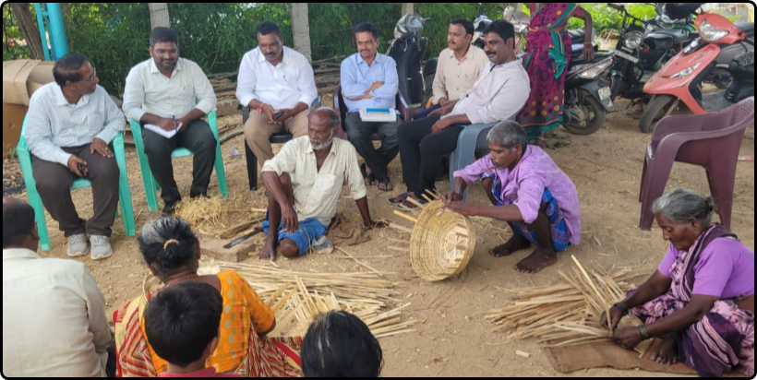
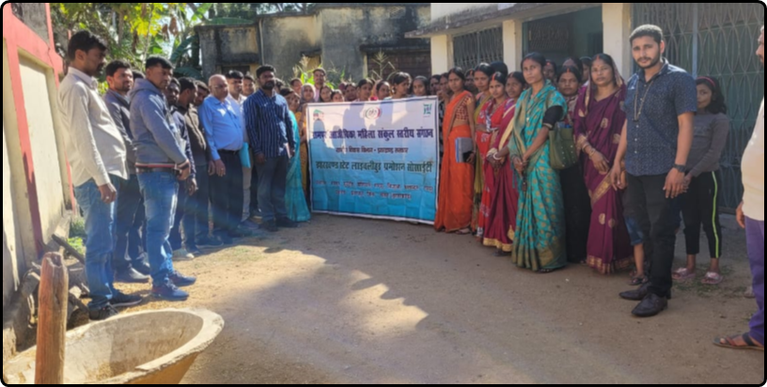
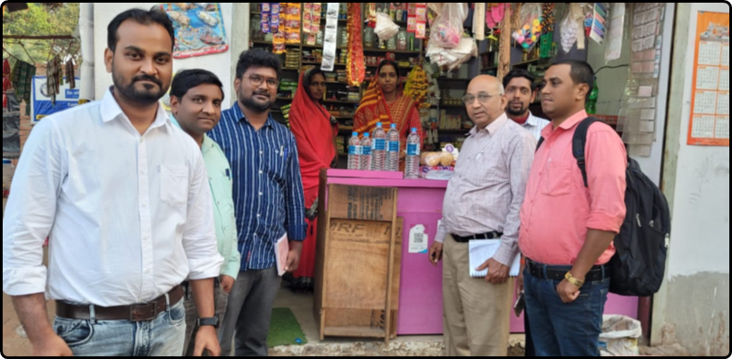
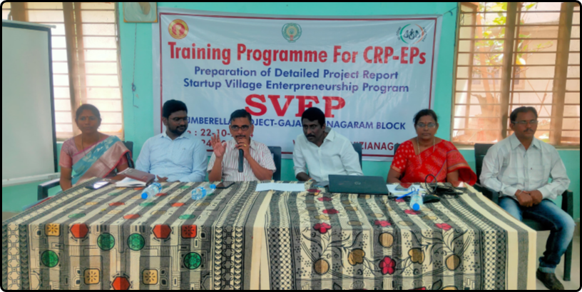
ni-msme & NRO Activities
Survey for DPR Preparation
Community Meetings and FGDs
Enterprise Survey
Trainings Programmes for SVEP
National Institute for Micro, Small and Medium Enterprises (ni-msme), Hyderabad
32

Slide 33





DNT Seed Scheme Sponsored by Ministry of Social Justice, Govt. of India
Scheme for Economic Empowerment of Denotified, Nomadic, and Semi-Nomadic Tribes (SEED)
  Identification of DNT Communities
  Self-Help Group (SHG) Formation
  Registration Process & Bank Account Opening
  Entry-Level Activities & Linking to Scheme Entitlements
  Upgrading the required Skill sets
ni-msme is working as a partnering agency to implement the SEED Scheme in six districts on a pilot basis. Currently, ni-msme has formed 300 SHGs and various DNT/NT/SNT groups, representing more than 26 different communities. A total of 3,645 DNT SHGs members are benefiting under the scheme.
Educational Empowerment
Health Insurance
Providing high-quality coaching to DNT candidates to help them prepare for competitive examinations, including Civil Services and professional courses like medicine, engineering, and MBA.
Offering health insurance through the Pradhan Mantri Jan Arogya Yojana (PMJAY) to ensure access to medical care for DNT communities.
Livelihood Initiatives
Housing Assistance
Community-Level Support: Facilitating livelihood initiatives to support income generation and enhance economic stability within DNT communities.
Financial Aid: Providing financial assistance for the construction of houses for members of DNT communities, ensuring better living conditions and stability.
National Institute for Micro, Small and Medium Enterprises (ni-msme), Hyderabad
33

Slide 34
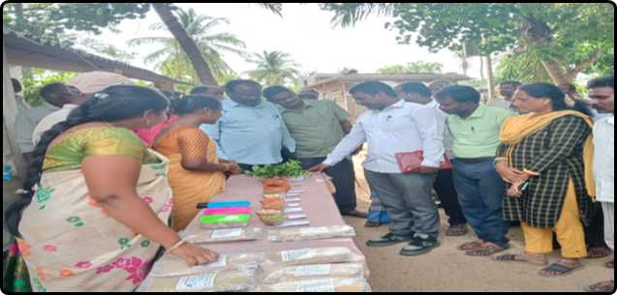
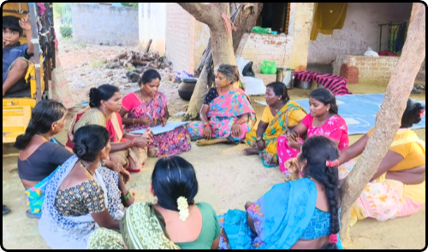
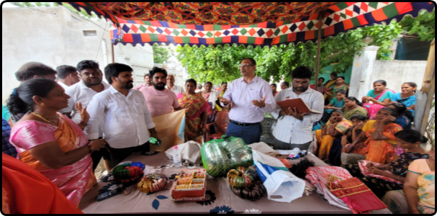
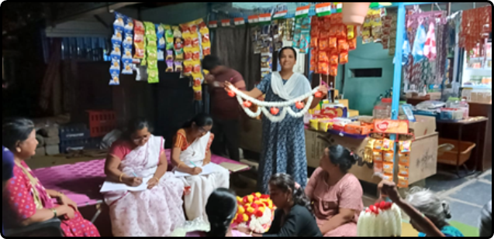
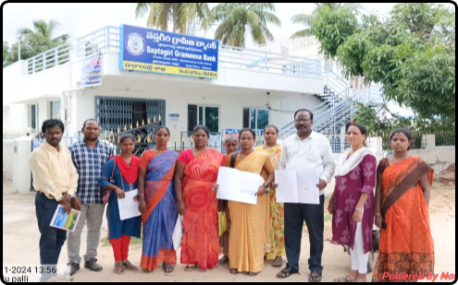
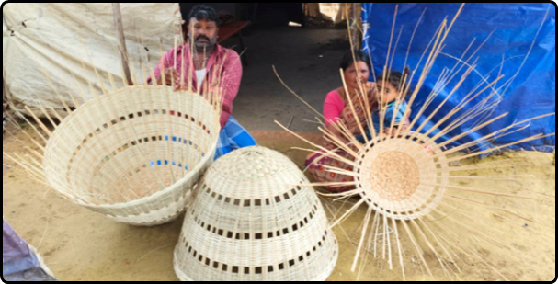
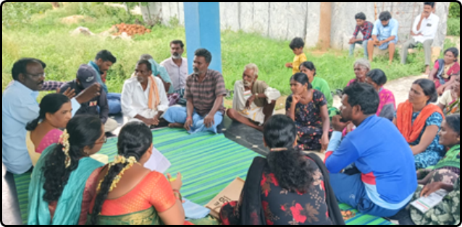
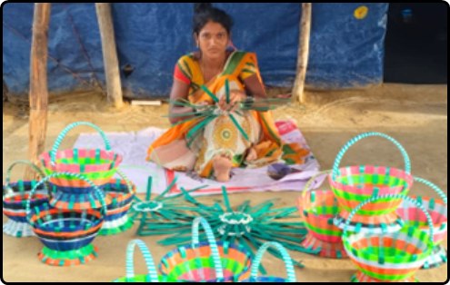
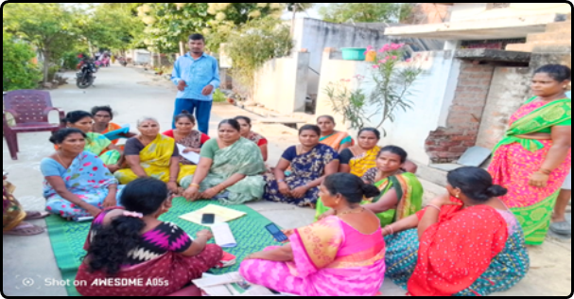
DNT Seed Project Activities
National Institute for Micro, Small and Medium Enterprises (ni-msme), Hyderabad
34

Slide 35

Background
As per NSSO survey (2013), there are around 5.77 crore small/micro units in the country, engaging around 12 crore people, mostly individual proprietorship/Own Account Enterprises.
Over 60% of units are owned by persons belonging to Scheduled Caste, Scheduled Tribe or Other Backward Classes.
Most of these units are outside the formal banking system and hence are forced to borrow from informal sources or use their limited owned funds.
MUDRA Loan Scheme has been proposed to bridge this gap.
National Institute for Micro, Small and Medium Enterprises (ni-msme), Hyderabad
35

Slide 36

Pradhan Mantri Mudra Yojana (PMMY)
MUDRA Loans Categories
  Shishu : Loans upto ₹ 50,000
  Kishore : Loans from ₹ 50,001 to ₹ 5 lakh
  Tarun : Loans from ₹ 5,00,001 to ₹ 10 lakh
Mudra loans limit is enhanced to ₹20 lakh from ₹10 lakh for those who have availed and successfully repaid loans previously taken under the Tarun category
Purpose
  Business purpose
  Capacity expansion and
  Modernization
Nature of Assistance
  Term loan
  OD limit
  Composite loan
for acquiring capital assets and/or working capital/ marketing related requirements
‘fund the unfunded’
National Institute for Micro, Small and Medium Enterprises (ni-msme), Hyderabad
36

Slide 37

Pradhan Mantri Mudra Yojna (PMMY)
MUDRA CARD
Eligible Borrowers
  Individuals
  Proprietary concern
  Partnership Firm
  Association of persons (AOP)
  Limited Liability Partnership (LLP)
  Private Ltd. Company
  Any other legal forms
  Lending Institutions
  All bank branches
  (Public Sector, Private Sector & RRBs)
  NBFCs
  MFIs
engaged in financing for micro enterprises and small business activities
National Institute for Micro, Small and Medium Enterprises (ni-msme), Hyderabad
37

Slide 38
Major Activities Covered under PMMY
Manufacturing: Small Manufacturing units like Automobile, Electrical, Packing, Furniture, Metal Gates & Grills
Trading: Provision Shopkeepers, Fruits and Vegetable Vendors
Services: Salons, Beauty Parlors, Gyms, Tailoring shops, Dry cleaning, Repair shops, Medical shops, Courier agents
Food Products: Papad making, Achaar making, Jam/Jelly making, Sweet shops, Food stalls, Catering services
Agriculture: Poultry, Dairy, Beekeeping, Agricultural Produce Preservation
Transportation: Auto Rickshaws, Small Goods Transport Vehicles, 3 Wheelers, e-Rickshaws, Taxis
National Institute for Micro, Small and Medium Enterprises (ni-msme), Hyderabad
38

Slide 39

Performance of MUDRA Scheme
National Institute for Micro, Small and Medium Enterprises (ni-msme), Hyderabad
39

Slide 40

Thank You
dg@nimsme.gov.in

