Slide 1
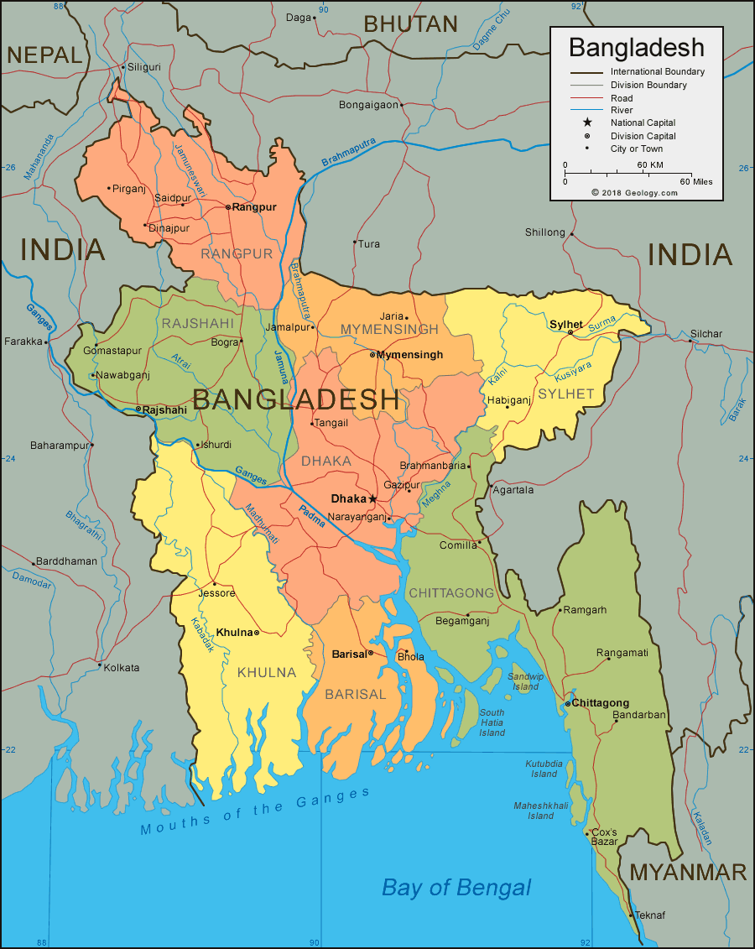
Strategic Environmental Assessment and Sustainable Regional Development in Bangladesh
Dr Zobaidul Kabir

Slide 2
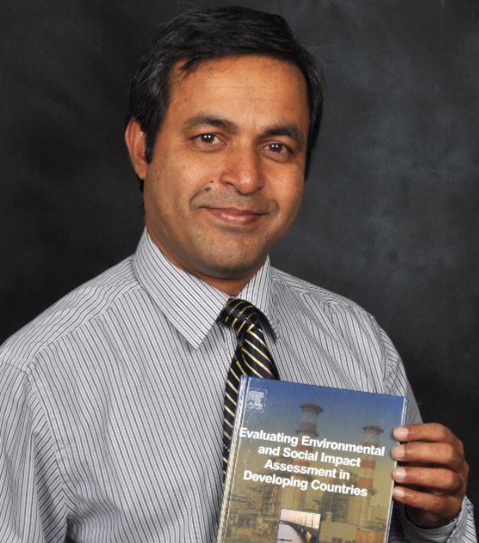
About me
PhD on EIA (UoN), Australia
Postdoc (ESIA and SRD), CQUniversity, Australia
Postdoc (SEA), University of Otago, NZ
Environmental and Social Planner (PIA)
Worked with UN system, CQ University and Otago University
Publications https://scholar.google.com/citations?user=wyqJ02sAAAAJ&hl=en

Slide 3
What is SEA
A systematic and comprehensive process for evaluating and anticipating the environmental and socioeconomic consequences of PPPs for decisions taken before the project stage (Therivel et al., 1992; Briffett, 2003)
Its purpose is to ensure that environmental considerations and alternatives are addressed as early as possible and on a par with economic and social factors in PPPs development (Sadler and Verheem, 1996, p. 26).
SEA is a process not an end-product or a means not an end

Slide 4
What is SEA
The strategic component of a SEA refers to the set of objectives and principles that give shape to the vision and development intentions incorporated in a policy, plan or program (PPP).
SEAs deal with concepts and goals not with activities or actions

Slide 5
Benefits of SEA
Helps to achieve environmentally sound and sustainable development
Strengthens policy, plan and program making processes
To identify cumulative effects
Saves time and money
Improves good governance and public trust/ownership in policy, plan and program making

Slide 6
SEA for Sustainable Regional Development

Slide 7
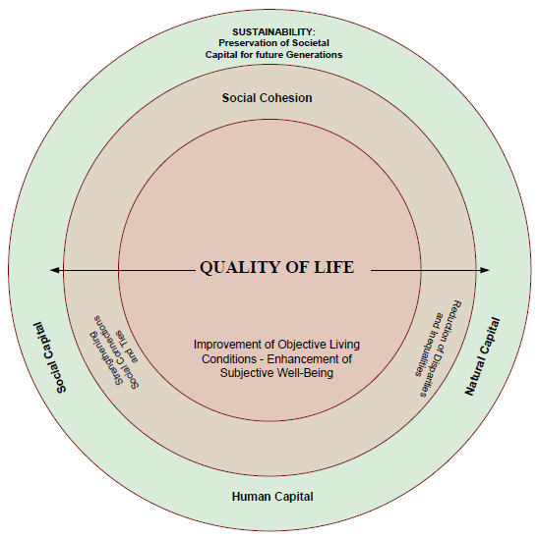
Improved Quality of Life

Slide 8
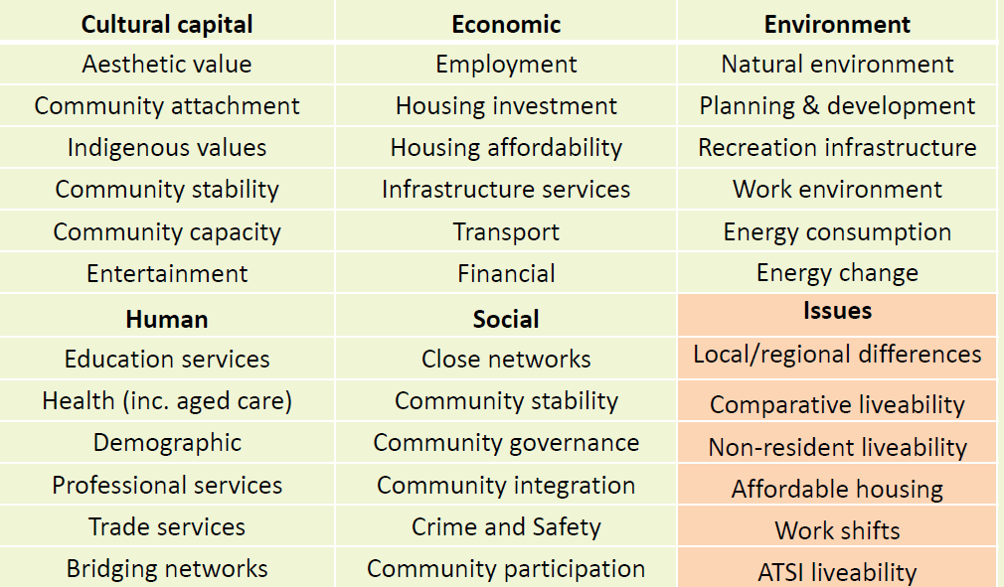
Quality of Life

Slide 9
Bangladesh and SEA
Bangladesh is one of the emerging economies with faster and stable economic growth rate (more than 6%)
Vision 2031 to graduate from LDCs and vision 2041 to become a high-income country
Bangladesh Delta plan-2021: an ambitious plan to achieve sustainably developed Bangladesh (will require huge investment)
Notes:
the government of Bangladesh
is taking large size programs/projects as to realise policies towards significant economic growth
and to graduate from LDC (Least Developed Country) status

Slide 10
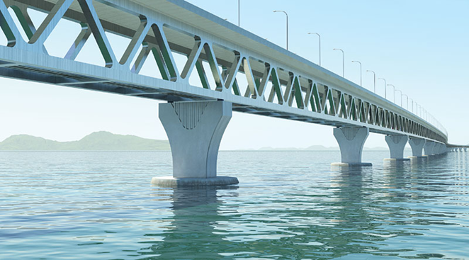
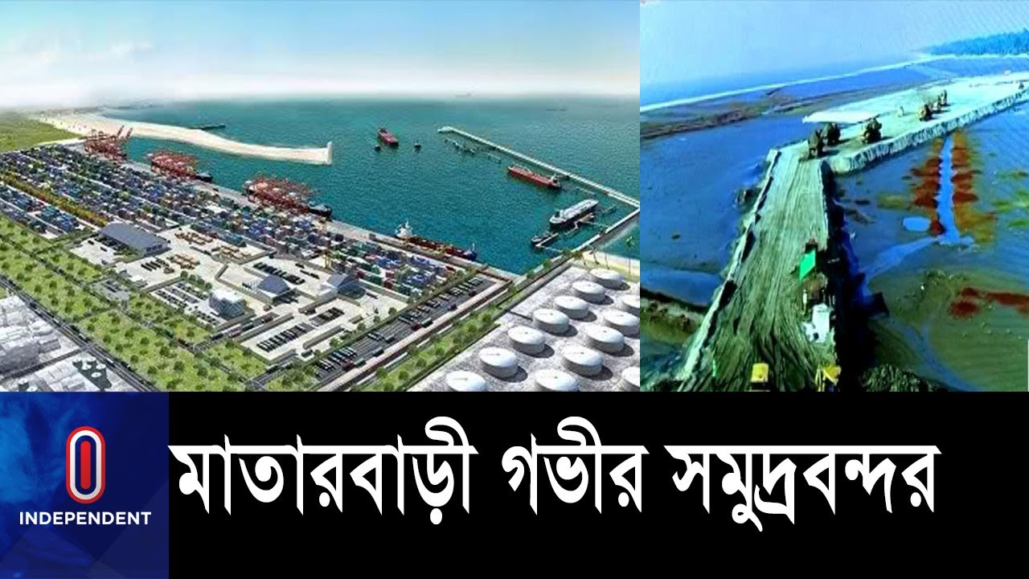

Contd.
Remarkable economic activities including huge investment in mega-projects at various sectors transportation (e. g. port), Energy (e.g., Power plants), and Economic Zone.

Slide 11

SEA for SRD in Bangladesh
Reduction of agricultural land (66000 acres/year, Jahangir et al., 2015)
Rapid urbanization (without plan)
Densely populated country (high ecological footprint)
Population growth continues
Potential impact on natural resources, ecosystems and habitats
Leading to the loss of biodiversity and unacceptable levels of pollution (soil, water, air)

Slide 12
Legal arrangements for SEA
Bangladesh has not yet endorsed its SEA requirements into Conservation Act (ECA) of 1995 (revised in 2010) and ECR of 1997 (revised in 2023)
The National Environmental Policy of 1992 (revised in 2018) incorporated the requirement of SEA of mega projects and PPPs
Constitution of Bangladesh: Article 18A underscores the protection of environment for current and future generation

Slide 13
Institutional arrangement for SEA
The Department of Environment (DOE) responsible for the enforcement of environmental regulations including the approval of EIA
The Ministry of Environment, Forest and Climate Change is to oversee the activities of DOE including the approval of SEA
Parliamentary Committee headed by a Members of Parliament to oversee the activities of MoEFCC
Environmental Courts/tribunals under Environmental Court Act 2000
Planning Commission

Slide 14
Practice of SEA in Bangladesh
SEA for Dhaka metropolitan development in 2007 ( World Bank Funded)
SEA for Detail Area Plan for Dhaka city in 2008 (World Bank Funded)
SESA for River stabilization plan, Bangladesh, 2016 & 2018 by NCEA
SEA of NW region for protection of Sundarbans (R-SEA)

Slide 15
Limitations/Challenges/Constraints
Absence of Act: no regulatory requirements for SEA
No Guidelines: needed sector-wise guidelines with appropriate methodology, tools and techniques
Lack of experts/capacity: understanding various aspects of PPPs and quality review of SEA
Low environmental priority: much more focus of climate change impacts
Notes:
Town Improvement Act (TI Act), 1953 which empowers RAJUK to develop Land Use Plan

Slide 16
Limitations/Challenges/Constraints
Awareness on SEA: low awareness and understanding of SEA among decision makers
Centralized decision making: advantage or disadvantage??
Transparency in decision making: techno-rational vs value laden??
Tiering: SEA-ESIA tiering is yet to be well understood
Interagency Coordination: Vertical and horizontal
Notes:
Tiering means that by preparing a sequence of environmental assessments at different planning levels and linking them, foreclosure may be prevented, postponement of detailed issues may be permitted and assessments can be better scoped. A tiered approach minimise the problem of Environmental Impact Assessment (EIA) being only a ‘snapshot in time’. Accordingly, the EU SEA-Directive (2001/42/EC) explicitly assumes tiering of SEAs and EIAs at different planning levels and the SEA- and EIA-Directive are directly linked (e.g. article 3(2) of Directive 2001/42/EC requires SEA for those plans and programs, which set the framework for future development consent of EIA projects

Slide 17
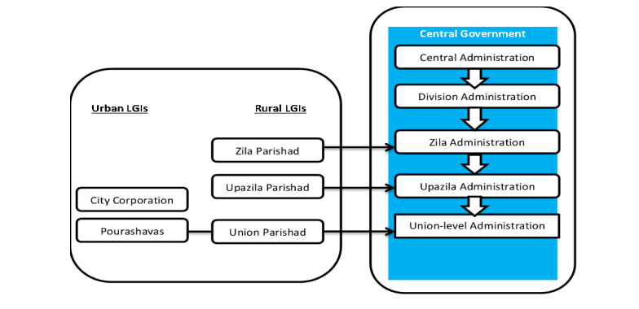
Local Government System in Bangladesh
Municipalities: 330
Unions: 4571
Upazila: 495
City corporations: 12
Source: Adopted from (Ahmed et al, 2014)

Slide 18
Role of local government in SRD
Article 59(2): Local Government bodies shall perform
(a) the maintenance of public order;
(b) the preparation and implementation of plans
relating to public services and economic development.

Slide 19
Role of Local Government
The Section 16 of the Constitution for the improvement of quality of life/or livability through, for example:
promotion of livelihood sources (e.g., agriculture, SCIs),
electrification,
education,
communications/transportations, and
public health.

Slide 20
Role of Local Government
Consistent with PP2041, the main goal of the LGRD&C sector is to achieve “effective, accountable and equitable local government system, and rural development in Bangladesh”
This is essential to take Bangladesh to the path of an UMIC by FY2031

Slide 21


The 8th Five Year Plan (2021-2025)
Local government has a vital role in the improvement of quality of life:
Participatory approach
Inclusiveness: leaving no one behind

Slide 22
Progress: Urban/regional planning
Physical/Master Plan LGED under the policy of LGD has so far developed
in 254 Pourashavas and
in 2 City Corporations
In addition, 6 more were prepared by the UDD and other development authorities.
The remaining municipalities are awaiting the preparation of the Plan

Slide 23
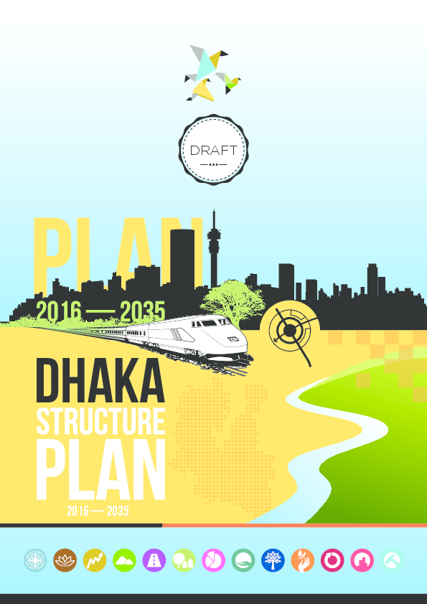
The way forward
Need to undertake SEA for already developed and
future sectoral or sub-sectoral plans, master plans
and programs: such as
Draft Dhaka Structure Plan Report 2016-2035
Master Plan for Haor Area
Master Plan for Agricultural Development
in the Southern Region of Bangladesh (2013)
https://www.dhakatribune.com/bangladesh/government-affairs/2019/02/10/pm-local-govt-will-be-strengthened-through-decentralization-of-power

Slide 24
The way forward
Incorporation of SEA requirements in ECA of 1995 is immediately needed: for certainty, transparency (quality assurance), and enforcement.
International good practice need to be in place with sectoral Guidelines ( However, context matters).
Capacity Building for government officials, planners and others
(research and training)
Land use plan in addition to other future sectoral plans need to be developed immediately using SEA
Bangladesh Delta plan-2021: R-SEA will be need to undertake for 6 geographic hotspots

Slide 25
The way forward: interagency coordination
Planning Commission
MoEFCC and DoE
Stakeholder Engagement
Sectoral Agencies/Ministries

Slide 26
Conclusions
From Bangladesh perspective, lack of legislation may point to lack of practice of SEA for regional development
However, hope is there as political will is inherently in place
The undertaking of SEA has been started in some sectors
Key example of the SEA of SW region to protect Sundarbans
SEA is a constitutional obligation- interoperation and subsequent legislation is required

Slide 27


Slide 28
THANK YOU

